Slide 1
American Express Campus Analyze This 2018
Final Submission

Slide 2
Team Details
Team Name :
Name | Campus | Roll No. | Mobile No. | Email Id
Ashutosh Kumar | IIT Kharagpur | 14GG20010 | 8145859343 | ashutoshk124@gmail.com
Rahul Singh | IIT Kharagpur | 14HS20029 | 8145834358 | srahul1502@gmail.com

Slide 3
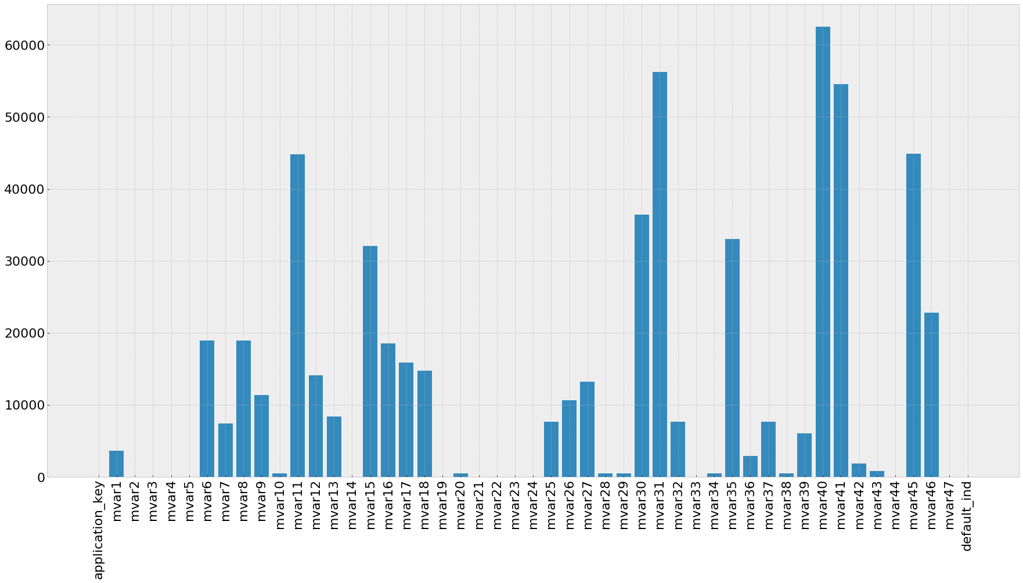
Estimation Technique Used
Please provide the estimation/modeling technique(s)/approach used to arrive at the solution/equation
There are 3 parts in the solution
Feature Selection
Missing value imputation using kNN Algo.
During Missing data imputation, not all the values were imputed. If feature importance of that attribute is high, then missing values for that variable is imputed. Missing Value imputation was done for - ['mvar1', 'mvar6', 'mvar7', 'mvar8', 'mvar9', 'mvar18', 'mvar25', 'mvar26', 'mvar27']
Under-Sampling
Almost 25% data has target variable 1s. Hence, 20,000 1s and random 20,000 0s were clubbed and used for training. This was done 20 times and the avg. probability across these 20 models were used to predict final probability.
Decision Trees ML Model : LightGBM
Missing Data Statistics

Slide 4
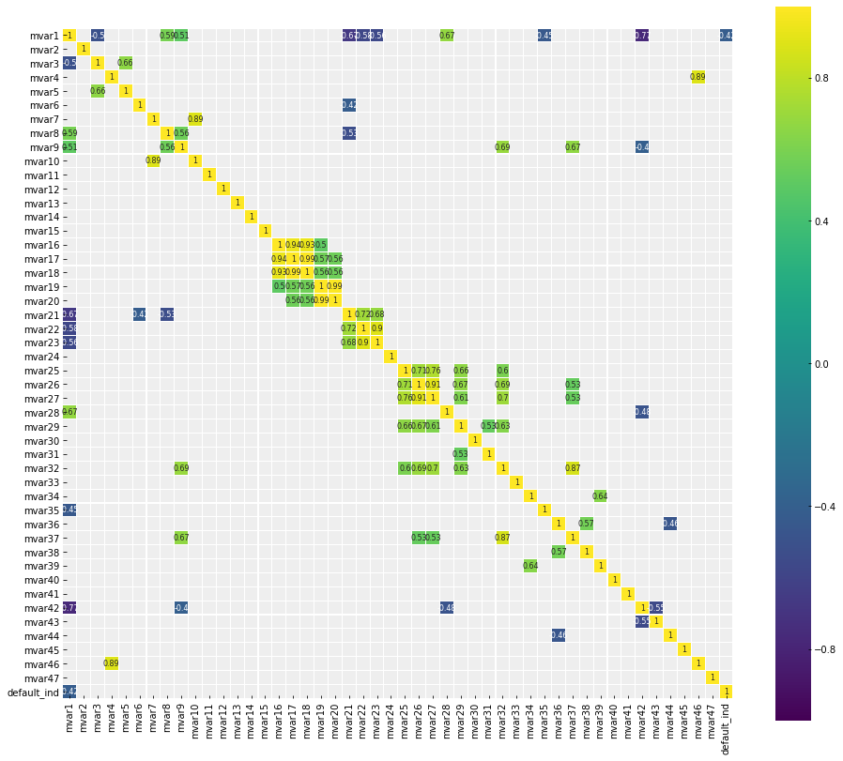
Strategy to decide final list
Please provide the strategy employed to decide the final list for submission
Once the first 3 steps were completed. We trained a supervised Decision Tree model over the train dataset and found the raw probabilities of our target variable between 0-1 for the test dataset.
After that, we sorted the applications on the basis of the probabilities found in increasing order – 0 means no default and 1 mean default.
Then we decided a threshold probability between 0-1 that divides the test data into 25% - 75 % ratio of 0s and 1s on target variable to match this ratio in the train dataset.
This gave us the list of applications in the decreasing order of probability to default.
Correlation Graph

Slide 5
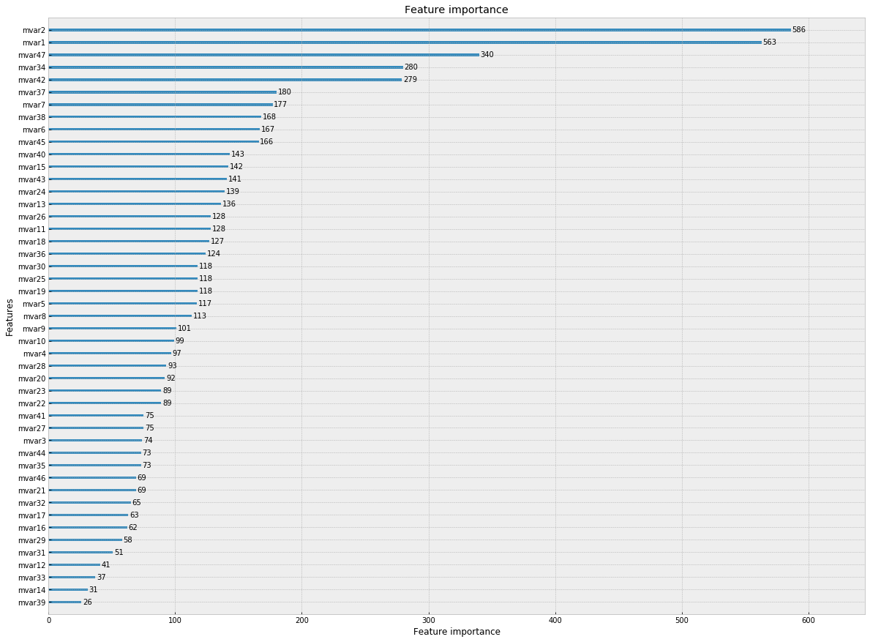
Details of each Variable used in the logic/model/strategy
Please provide details of each variable used in the final logic
Instead of saying why we selected the variables, we would like to highlight the reasons for deleting some of the attributes from our train dataset. We employed two methods before deleting the variables/attributes
Correlation Heatmap(refer slide 3
According to the correlation heatmap, the following tuple of attributes were highly co-related.
(16, 17, 18), (19, 20), (32, 37), (46, 4), (7, 10). Out of the closely related attributes, we deleted the ones with most missing values. – (16, 17, 20, 37, 46, 7)
Feature Importance Plot
Last 3 least imp features were removed from train set.

Slide 6
Reasons for Technique(s) Used
Why do you think this is the best technique(s) for this particular problem?
This could be ONE OF THE BEST SOLUTIONS as
The data contained a lot of missing values, but instead of truncating the data, we imputed them with another unsupervised model. In fact, not all the missing data was imputed as imputing all would create another bias in the model.
Averaging of probabilities was done for multiple models (sort of stacking) to ensure that the model fits very well when it faces a new dataset (test dataset)
We respected the bias present in the target variable and used sampling methods to training our model.
We used a light weight and latest improvised machine learning model developed by Microsoft – LightGBM. The model fits very well across missing values, un-standardized values.

Slide 7
Final Submission File
Please embed your final submission file (.csv) here.

Slide 8
THANK YOU

